Slide 1


Spiking Neural Networks
Timothée Masquelier
timothee.masquelier@cnrs.fr
ISAE Feb 2021

Slide 2
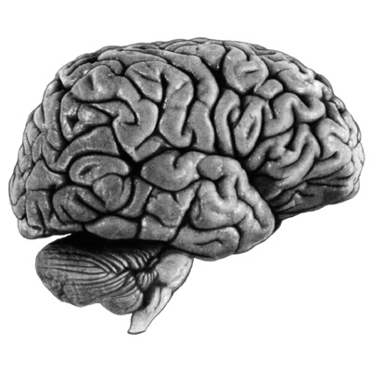
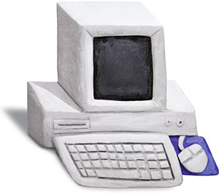
What is computational neuroscience?
Simply put, it is the field that is concerned with how the brain computes. The word “compute” (…) refers to the operations that must be carried out to perform cognitive functions. (…) Computational neuroscience (…) seeks a mechanistic understanding of these operations, to the point that they could potentially be simulated on a computer. Romain Brette
What I cannot create, I do not understand. Richard Feynman, 1985

Slide 3
In praise of neuromorphic engineering
Biological nervous systems are optimized by natural selection in terms of: speed, robustness, energy consumption, learning (speed, flexibility, generalization)
High performances despite:
Slow hardware (firing rates ≤ 100Hz, conduction ~1-2m/s)
Unreliable hardware
“Only” ~ 4.10^9 neurons in the human visual system
much room for improvements!

Slide 4
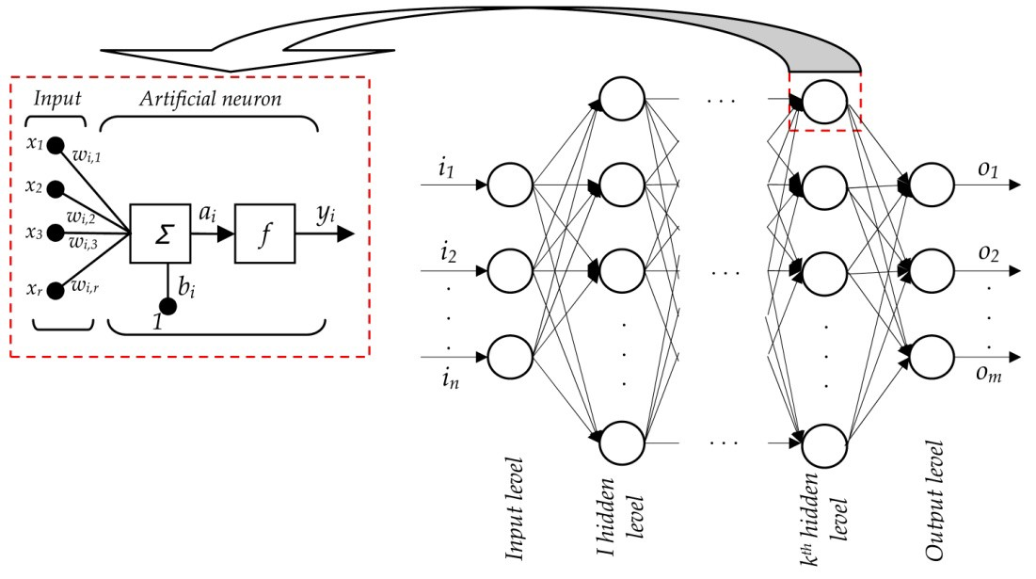
Artificial Neural Networks (ANN) (feedforward)
Notes:
The output of some neurons is connected to the input of some other neurons to form a directed weighted graph
The network is said to be feedforward if the graph is acyclic.
Learning (or training) = tuning the weights (and biases).
Activations are continuous valued and static.

Slide 5
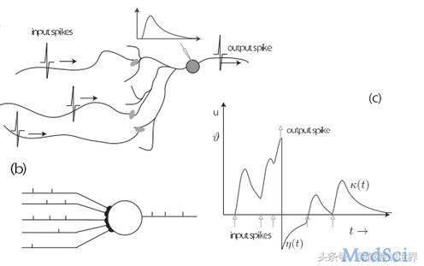
Biological neurons emit “spikes”
EPSP
Input spikes
Output spike
Output spike
Input spikes
Spikes are stereotyped electrical impulses (“all-or-none”) that a neuron emits when sufficiently stimulated
They propagate along the axons without attenuation (“active propagation”).
Neurons can only exchange information via spikes.
Notes:
Membrane potential is private.

Slide 6
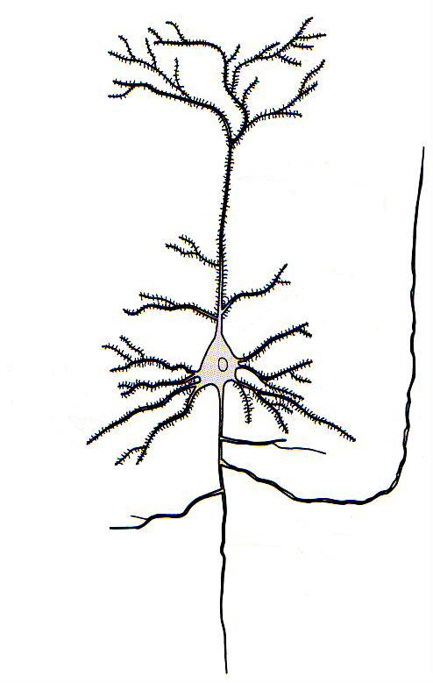
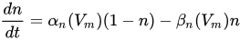
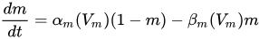
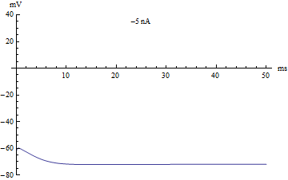
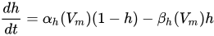
A biophysical model: the Hodgkin–Huxley model
Ionic current dynamics:
I_{inj}
I_{inj}=
Subthreshold + spike dynamics are modelled
Hodgkin & Huxley 1952

Slide 7
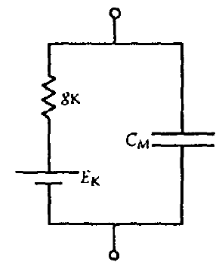
A phenomenological model: the Leaky Integrate and Fire neuron
Only the subthreshold dynamics are modelled :
outside
I_{inj}
R
C
E_{L}
I_{inj}
V_{m}
inside
with
Membrane time constant
(typically 3-100 ms)
If V = V_{t} (threshold) then: neuron spikes and V→V_{r} (reset)

Slide 8
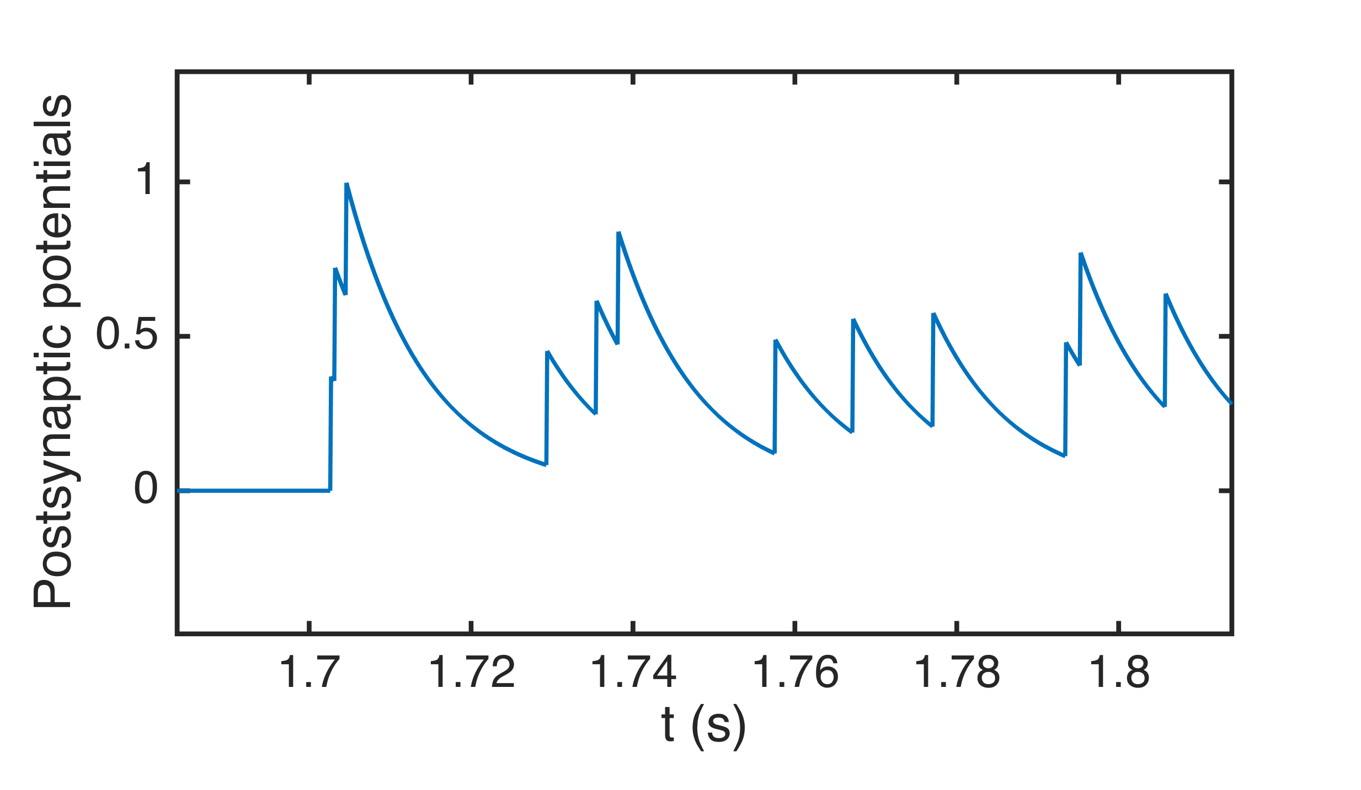
The LIF’s response to input spikes
Or, equivalently:
If V = V_{t} (threshold) then: neuron spikes and V→V_{r} (reset)

Slide 9
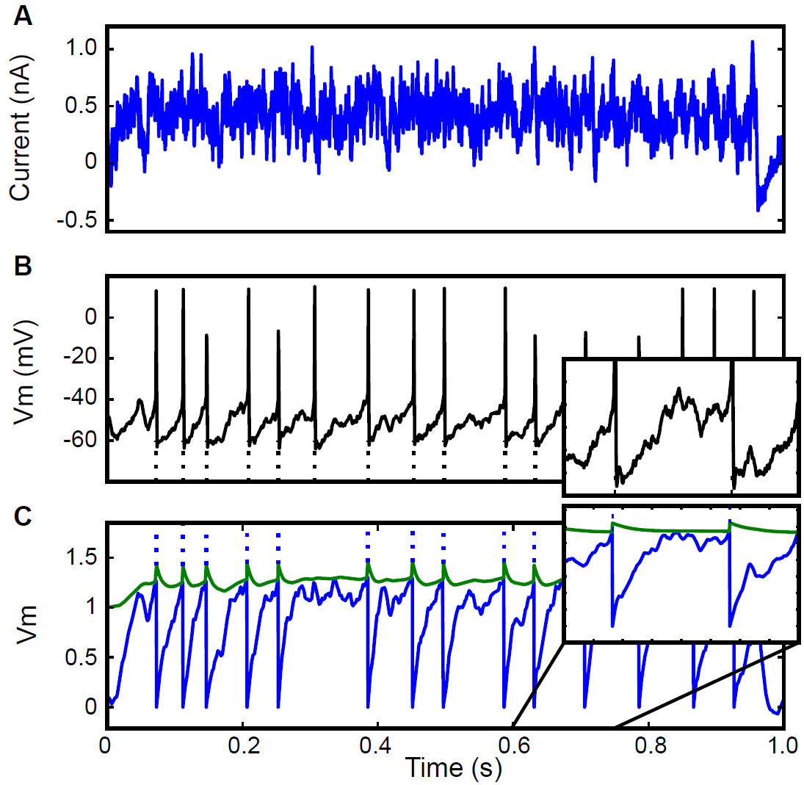
By the way: the LIF model is not a bad model of cortical neurons
Injected current (slice)
Fast spiking cortical cell
LIF model with adaptive threshold
Gerstner & Naud. Science. 2009

Slide 10
2 levels of description
w₁
Afferents
w_{n}
Spike-based description
Rate-based description
Steady state
f
Coincidence
detector
Integrator
output = f( Σ w_{i} . input_{i} )

Slide 11
Neurons as coincidence detectors
Input spike:
d
Same spike train
Time lag d
Threshold =
Thr.
Thr.
output spike
1
no output spike
0
Output spike if
Team Neuro.AI
11
Notes:
This is what neurons do.
Especially in the high conductance regime (in vivo).
They do no count spikes, they do not accumulate evidence.
Synchrony, or lack thereof, is an important element of the neural code.

Slide 12

Neurons as coincidence detectors
Input spike:
d
Rate-based models such as ANNs do not capture this crucial mechanism !
Same spike train
Time lag d
Threshold =
Thr.
Thr.
output spike
1
no output spike
0
Output spike if
Team Neuro.AI
12
Notes:
This is what neurons do.
Especially in the high conductance regime (in vivo).
They do no count spikes, they do not accumulate evidence.
Synchrony, or lack thereof, is an important element of the neural code.

Slide 13
SNNs for neuroscience
Unlike Artificial Neural Networks (ANNs), Spiking Neural Networks (SNNs) can capture:
An important neuronal function: coincidence detection
Dynamics: transients, oscillations, etc.
Fast processing, with few (1?) spikes per neuron

Slide 14
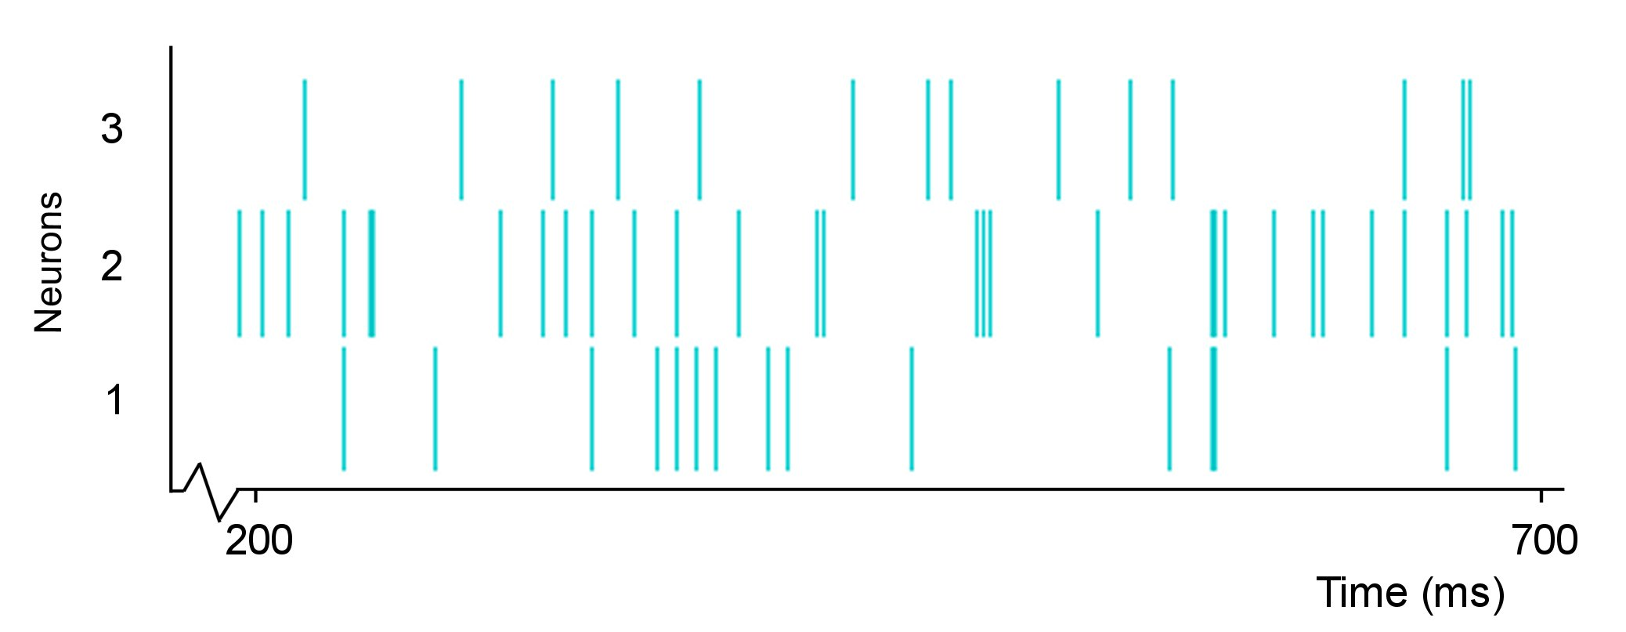
SNNs are appealing for AI
More computational & representational power than ANNs, due to an extra dimension: continuous time.
vs.

Slide 15
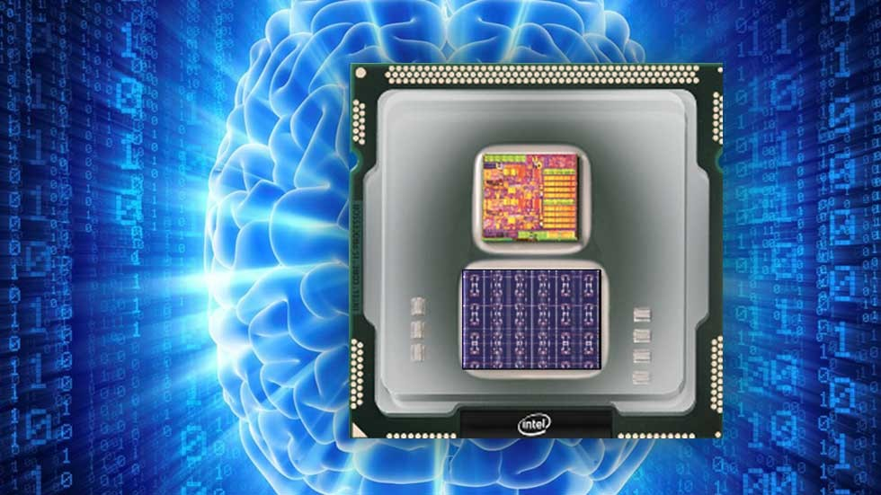
SNNs are appealing for AI
More computational & representational power than ANNs, due to an extra dimension: continuous time.
Particularly appealing for dynamic inputs (sounds, videos...)
Run best on dedicated “neuromorphic” chips (IBM True North, Intel Loihi, BrainChip Akida, etc.)
Intel Loihi (2018)

Slide 16
SNNs are appealing for AI
More computational & representational power than ANNs, due to an extra dimension: continuous time.
Particularly appealing for dynamic inputs (sounds, videos...)
Run best on dedicated “neuromorphic” chips (IBM True North, Intel Loihi, BrainChip Akida, etc.)
Efficient distributed event-driven & low power computation, especially if:
Spikes are rare (as in the brain!)
Connectivity is sparse (as in the brain!)
Different from GPUs, which perform synchronous dense tensor products (required for ANNs)

Slide 17
Training SNNs - Outline
Unsupervised learning
Spike timing dependent plasticity (STDP)
Application: visual feature extraction
Supervised learning:
Back-propagation & surrogate gradient

Slide 18
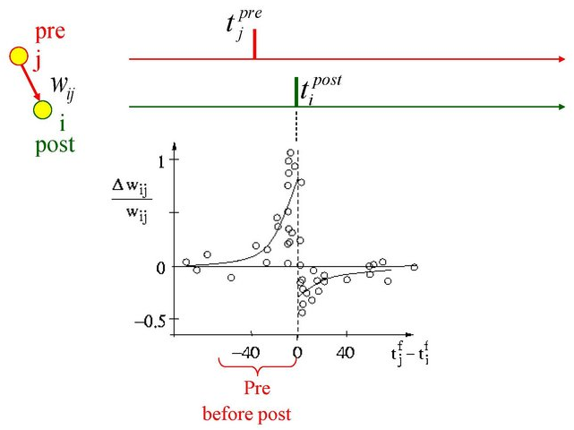
Spike Timing-Dependent Plasticity
(ms)
Bi & Poo, 1998
Notes:
18
La STDP est un mécanisme de modification de connexions synaptiques

Slide 19
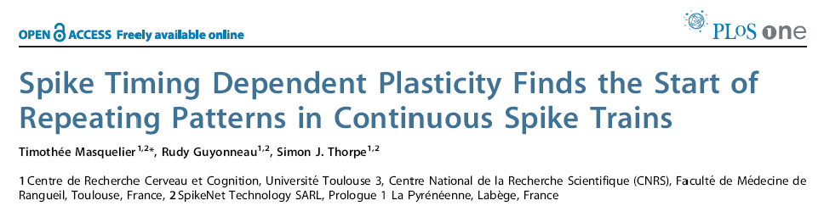
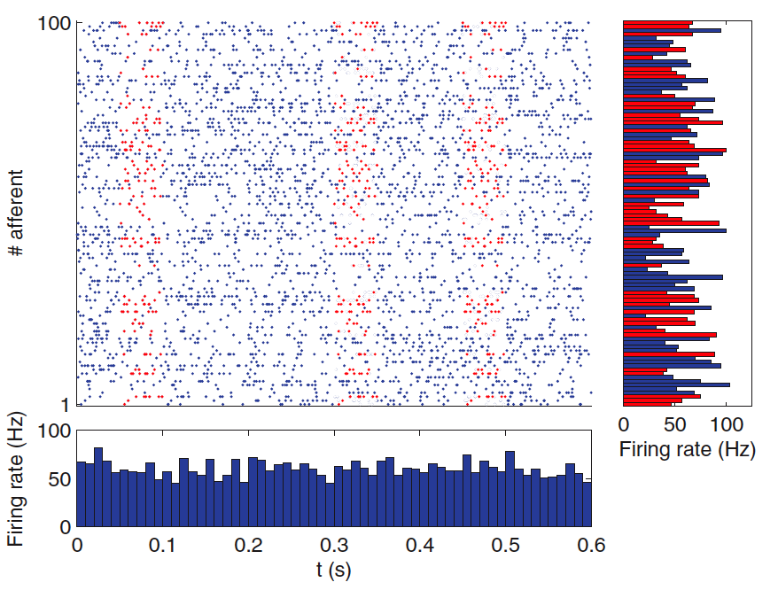
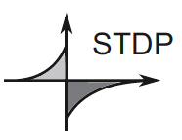
Notes:
19
Je vous ai montré un cas simplifié, mais même dans des cas plus réalistes…

Slide 20
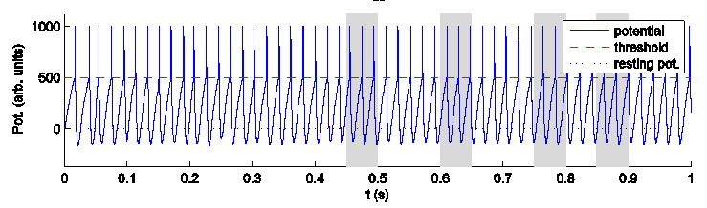
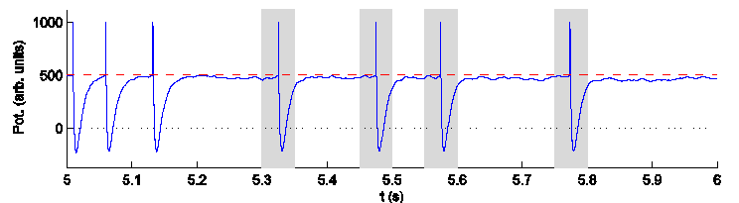
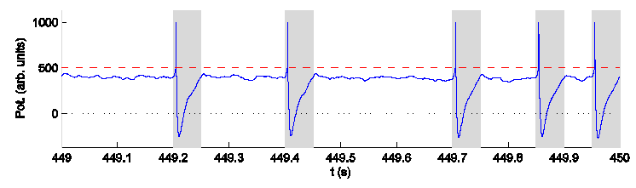
Results
Initial State
During Learning
After Learning
Notes:
Poids égaux + activité des afférent constantes => régime périodique.
LTD l’emporte sur LTD en cas de spikes décorrélés.

Slide 21
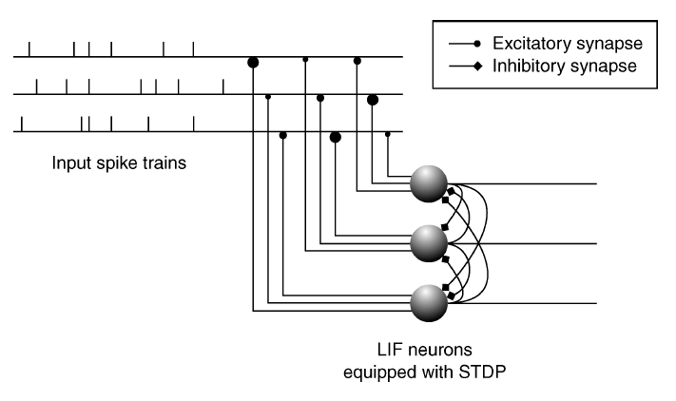
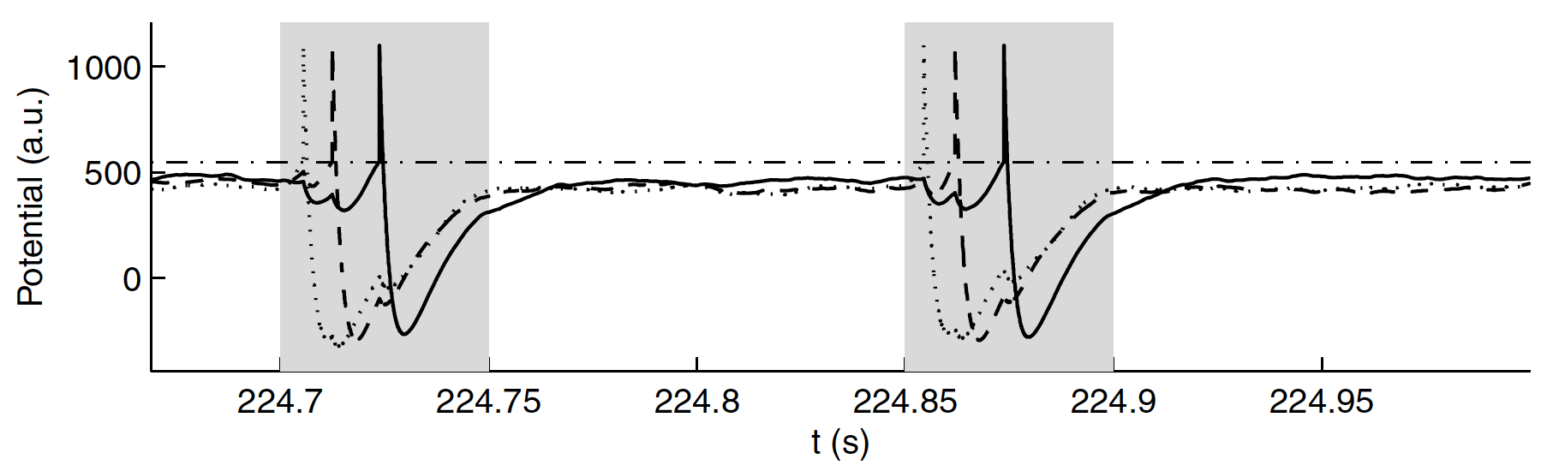
Learning the full pattern
Competitive learning
Neurons « stack »
Masquelier, Guyonneau & Thorpe 2009. Neural Comp

Slide 22
Application: visual processing
Repeating spike patterns
= repeating visual features

Slide 23
Speed of processing in the human visual system
E.g. saccadic forced-choice
In which of the two images (left or right) is the animal?
Notes:
Je vous ai parlé de sélectivité et d’invariance. Parlons maintenant de vitesse, avec d’abord des résultats de pschophysique

Slide 24
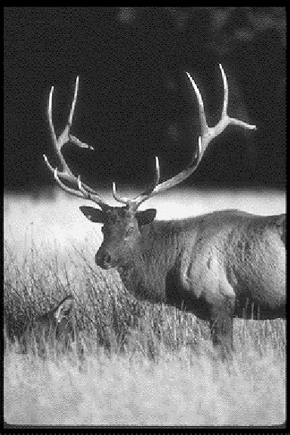


Slide 25
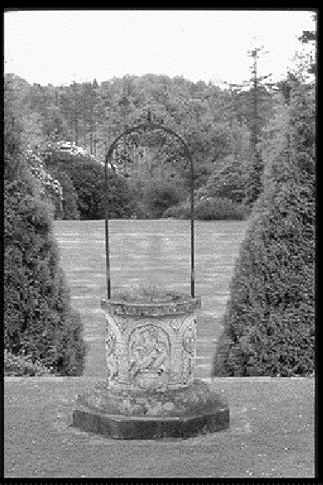
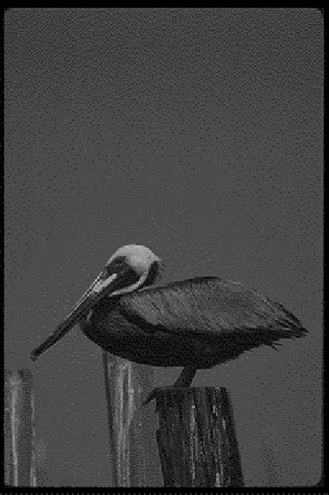

Slide 26
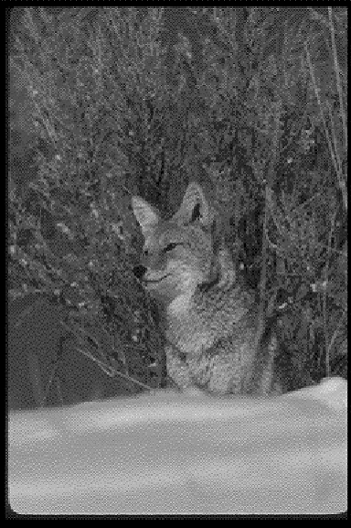
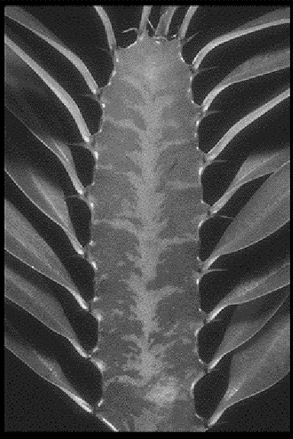

Slide 27
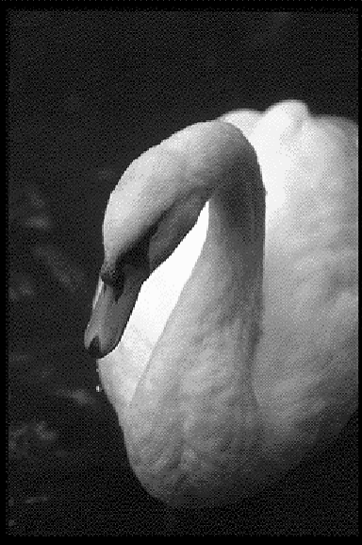


Slide 28
Visual system: speed Psychophysics
The eyes can move towards animals in as little as 120-30 ms!!! (Kirchner&Thorpe 2006)
It is even faster for faces: 100ms! (Crouzet, Kirchner & Thorpe 2010)
20-30ms for motor delays => visual processing must occur in 100 ms or less, and even less for faces
Notes:
La tache est facile et la vitesse impressionante

Slide 29
Visual system: speed Electrophysiology
IT
IT responses are rapid (100 ms) & selective to complex stimuli (e.g. faces) (Oram&Perrett, 1992; Keysers et al., 2001; Hung et al., 2005)
V4
V2
V1
LGN
Thorpe et al’s reasoning:
Retina
Arguments
1) Roughly 10 layers
2) 10 ms per layer
3) Firing rates 0-100 Hz
Therefore:
1) At most one spike per neuron
2) Mainly feedforward
3) The wave of first spikes does a lot!
Notes:
Si on enregistre des neurones dans IT…

Slide 30
Models of the ventral stream of the visual cortex
Feedforward
Convolutional (weight sharing) layers
Max pooling layers
Along the hierarchy
Selectivity increases
Invariance increases
At most one spike per neuron!
Fukushima, 1980; LeCun and Bengio, 1998; Riesenhuber and Poggio, 1999; Wallis and Rolls 1997; Rolls and Milward, 2000; Stringer and Rolls, 2000; Serre et al., 2007 + deep learning
Notes:
Temporal constraints => at most one spike per neuron

Slide 31
First layer: intensity-to-latency conversion
Spike
Spike
Activation
Threshold
Weak
Stimulus
Medium
Stimulus
Strong
Stimulus
No spike
Time
≠ intensity-to-rate conversion (conventional view)
Notes:
Quand on présente une image à la première couche: les neurones partent du repos puis…

Slide 32
First layer: intensity-to-latency conversion
Intensity
A
B
C
D
E
Spike waves

Slide 33

STDP-based deep feature extraction
Kheradpisheh, Ganjtabesh, Thorpe & Masquelier 2018. Neural Networks
Notes:
Competitive unsupervised learning
Learns visual patterns
Consistently present
Salient

Slide 34
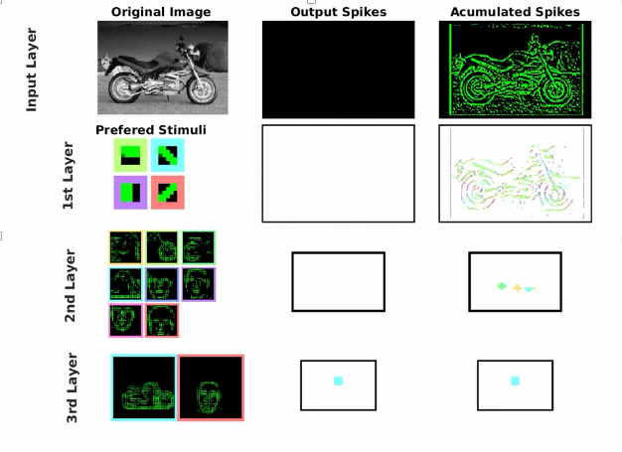
STDP-based deep feature extraction
Kheradpisheh, Ganjtabesh, Thorpe & Masquelier 2018. Neural Networks
Notes:
Competitive unsupervised learning
Learns visual patterns
Consistently present
Salient

Slide 35
Discussion
AI:
Accuracy does not match (yet?) deep learning but:
Energy efficient (sparse coding)
Hardware friendly
STDP is a local rule
Online, on-chip, learning
(Mostly) unsupervised learning
Only a few tens of labeled examples needed per category
Neuroscience:
Our proposal is compatible with
The temporal constraints (object recognition is fast in primates)
The fact that we learn mostly by observing the world, in an unsupervised way

Slide 36
Training SNNs - Outline
Unsupervised learning
Spike timing dependent plasticity (STDP)
Application: visual feature extraction
Supervised learning:
Back-propagation & surrogate gradient

Slide 37
What is backprop?
Supervised learning in feedforward ANNs
Fitting algorithm: the cost function L is the distance between actual and desired activations in the last layer (e.g. MSE, cross-entropy).
Optimal weights are found through gradient descent:
All gradients can be computed recursively (backward) using automatic differentiation (backprop = short for “backward propagation of errors”)

Slide 38
Backprop’s tour de force
Solves the credit assignment problem (i.e. what should the hidden layers do?)
Optimize features & classifier jointly
Nb of layers is arbitrary: opens the door for very deep nets
This motivated us (and others!) to adapt backprop to SNNs

Slide 39
Surrogate Gradient Learning (SGL)
In a nutshell:
Train SNNs with backprop through time
Time is discretized
The firing threshold causes optimization issues => use a “surrogate gradient”
In practice: use automatic differentiation (e.g. PyTorch, TensorFlow)

Slide 40
Leaky integrate-and-fire neuron Continuous time
Or, equivalently:

Slide 41
Leaky integrate-and-fire neuron Discrete time
Input spikes (in the time bin)
(leaky integration)
Leak
(output spikes)
(reset)

Slide 42
Backprop through time (BPTT)
S⁽²⁾[0]
S⁽²⁾[1]
S⁽²⁾[2]
Θ
Reset
Θ
Reset
Θ
Layer 2
1) Unroll the network to get a feedforward network
2) Train it with backprop
V⁽²⁾[0]
V⁽²⁾[1]
V⁽²⁾[2]
W⁽²⁾
W⁽²⁾
S⁽¹⁾[0]
S⁽¹⁾[1]
S⁽¹⁾[2]
Θ
Reset
Θ
Reset
Θ
Layer 1
β
β
V⁽¹⁾[0]
V⁽¹⁾[1]
V⁽¹⁾[2]
W⁽¹⁾
W⁽¹⁾
Input layer
S⁽⁰⁾[0]
S⁽⁰⁾[1]
S⁽⁰⁾[2]
Time

Slide 43
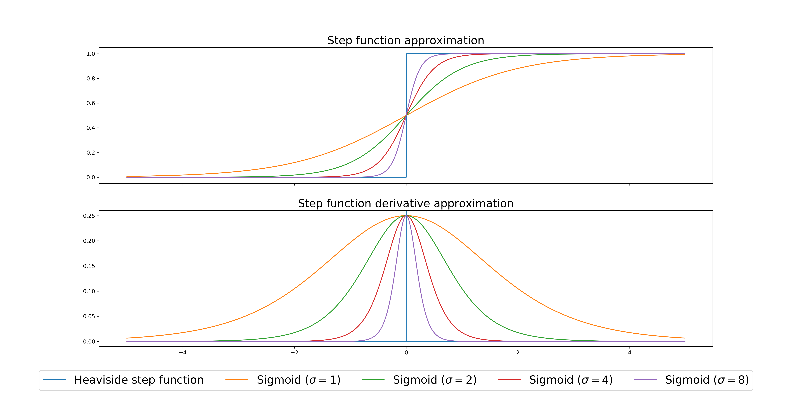
Surrogate gradient for Θ
Neftci, Mostafa & Zenke (2019) Surrogate gradient learning in spiking neural networks. IEEE Signal Processing Mag

Slide 44
Training SNNs with BPTT - Pros
Solves the spatial & temporal credit assignment pb
Handles:
Deep networks
Dense & conv. layers
Delays
Trainable τ
Agnostic about rate vs. temporal coding (≠S4NN, conversion)
Regularization can encourage sparse activity, fast processing, etc.
In practice: SNNs can be trained using PyTorch/TensorFlow
Automatic-differentiation
SOTA gradient descent algorithms (e.g. Adam)
CPU(s) / GPU(s)
Large community

Slide 45
Training SNN with BPTT - Cons
Memory hungry (linear with nb of time steps).
Does not take advantage of highly sparse tensors.
Not hardware friendly (but see Neftci et al.)
Not biologically plausible (but see E-prop)

